Slide 1


Tesla
Home chef
The Future of Culinary
Presented by TechMavu
Next Slide

Slide 2
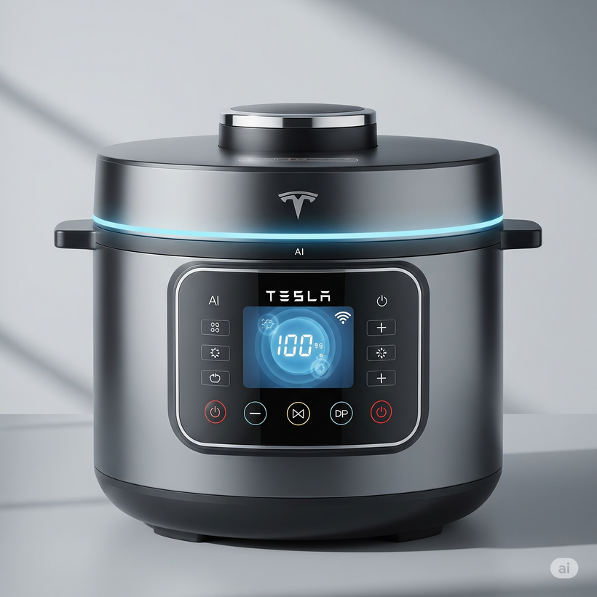
Product
Overview
The Tesla Home Chef is a revolutionary smart electric pressure cooker.
Integrates AI, energy efficiency, and intuitive UX.
Redefines home cooking: precision, speed, convenience.
Continuously evolves through software updates.
Next Slide

Slide 3
Simplify Complex Cooking
Enhance Efficiency
One-touch smart recipes, no guesswork.
Faster cooking with intelligent automation.
Product
Goals
Promote Healthy Living
Embrace Sustainability
Retains nutrients, supports diet-specific meals.
Energy-saving tech and eco-friendly design.
Next Slide

Slide 4

Intelligent
Cooking System
Autopilot Cooking System (ACS): AI adjusts pressure, temperature, time.
Cloud recipe library—personalized & updateable.
Sensor fusion: temperature, pressure, humidity, weight.
Integrated Smart Tools: built-in precision scale, wireless temp probes (ideal for sous-vide & precision cooking).
Next Slide

Slide 5
Tesla Energy Efficiency Core (TEEC): optimized induction heating.
Multi-layer vacuum insulation for heat retention & lower power use.
Smart power management (adaptive energy optimization).
Energy & Engineering
Excellence
15+ safety systems: pressure release, lid lock, thermal + electrical safeguard
Dynamically adjusts power usage based on recipe and ingredient load to minimize waste.
316L stainless steel pot; sleek brushed exterior with subtle LED accents.

Slide 6

Target
Audience
Tech Enthusiasts seeking cutting-edge smart appliances.
Existing Tesla Owners valuing ecosystem integration & sustainability.
Busy Families needing speed & reliability.
Health-Conscious Users optimizing nutrition & precision cooking.
Next Slide

Slide 7

Interface &
Connectivity
10" full-color HD touchscreen with contextual UI.
Voice assistant integration.
Remote control & monitoring via Tesla Home App.
AI suggestions, real-time alerts, recipe saving & management.
Seamless OTA updates: new recipes, performance optimizations.
Next Slide

Slide 8
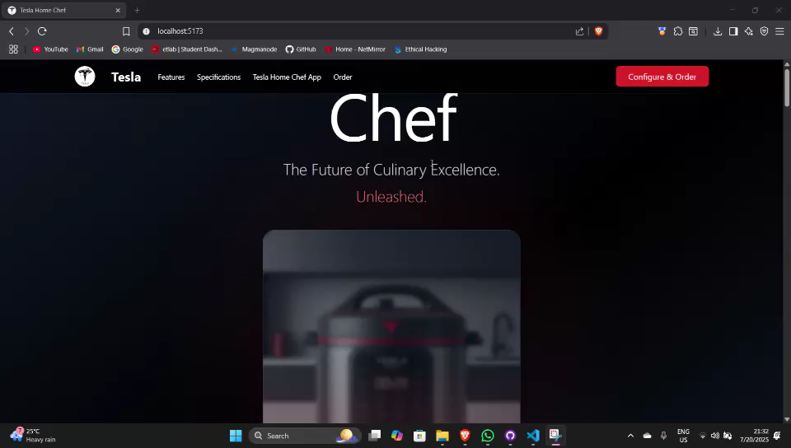
Next Slide

Slide 9
Thank
You!

